Slide 1

Welcome to our class
Phu Dong Primary School

Slide 2

Unit 1: Nice to see you again
Lesson 3

Slide 3

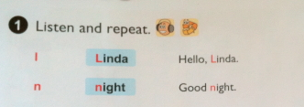
Unit 1: Nice to see you again
Lesson 3

Slide 4

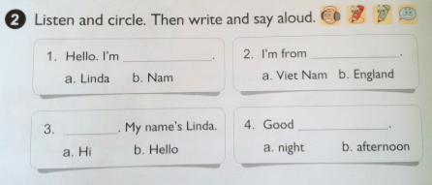
Unit 1: Nice to see you again
Lesson 3

Slide 5
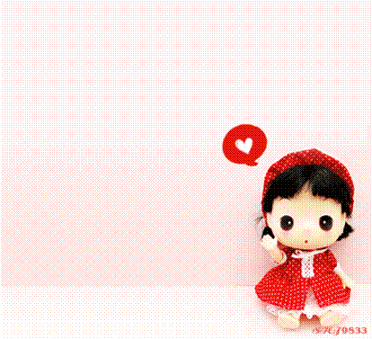
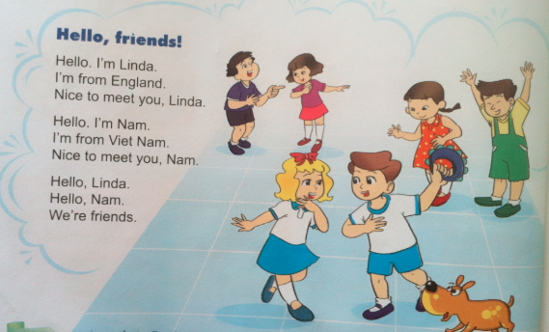
3. Let’s chant

Slide 6

Thanks for your listening!
Goodbye. See you later!
Notes:
6

